Slide 1
From Machine Learning
To foundations of
Deep Learning

Slide 2

Who am I?
I am Prakhar Srivastava.
Junior year, CS undergrad, currently working in the domain of Deep learning.
Anywhere social handle: @prakharcode
@web: www.prsr.me
Since I’m still a learner, I would love if you heckle me and not harass me.

Slide 3
PATH OF TALK
TIMELINE OF DEEP LEARNING.
SVMs
SVMs with KERNEL TRICK
CURSE OF DIMENSIONALITY
RESURGENCE OF NEURAL NETWORKS
NEW DEVELOPMENTS
APPLICATIONS AND OUTRO
Aim of the talk is not to make you an expert but to give you a slight insight into
Deep learning

Slide 4
What is Machine Learning?

Slide 5
What is Machine Learning?
A machine is said to "learn" from experience E with respect to some class of tasks T and performance measure P if its performance at tasks in T, as measured by P, improves with experience E.
-Tom M. Mitchell, former Chair of the Machine Learning Department at CMU

Slide 6
Wait What?

Slide 7

What is Machine Learning?
Simplified
At its core Machine Learning is a computable Mathematical tool which is used to approximate a function.
In short: Programming mathematics!
Notes:
At its core Machine Learning is a computable Mathematical tool which is used to approximate a function. This function is believed to be an “oracle” function or true function from which data is generated.

Slide 8
Basic tasks including Machine learning are:
Regression
Classification
Clustering
Data Generation

Slide 9
We got to learn about fundamental machine learning algorithm
Linear regression
Logistic regression
K Nearest Neighbour

Slide 10
Now let’s build learn about
Deep learning
Like it happened!

Slide 11
The time line of Deep learning

Slide 12
1943 - The first mathematical model of neural network
Notes:
Not a working model, also not like perceptron

Slide 13
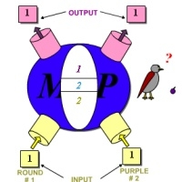
Walter pitts and Warren McCulloch neuron
Working demo
Notes:
Walter Pitts, a logician, and Warren McCulloch, a neuroscientist, gave us that piece of the puzzle in 1943 when they created the first mathematical model of a neural network. Published in their seminal work “A Logical Calculus of Ideas Immanent in Nervous Activity”, they proposed a combination of mathematics and algorithms that aimed to mimic human thought processes.
Their model – typically called McCulloch-Pitts neurons – is still the standard today (although it has evolved over the years).

Slide 14
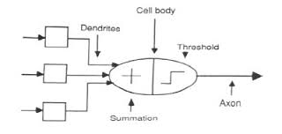
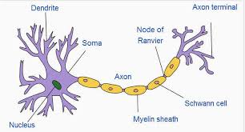
McCulloh-Pitts model and neuron

Slide 15
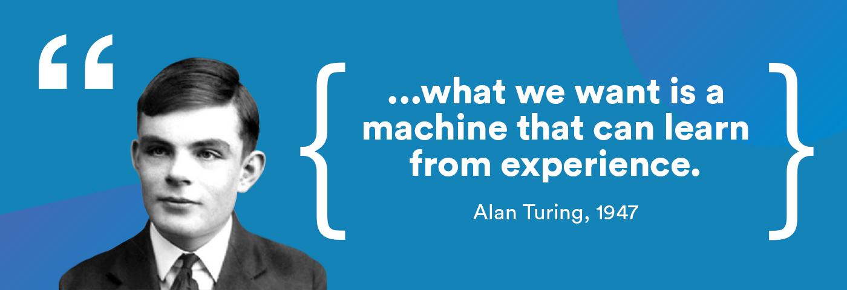
v
1950 - The prediction of machine learning by Alan turing
Formulation of Turing Test
A test we are still trying to win!
Notes:
In 1950, Turing proposed just such a machine, even hinting at genetic algorithms, in his paper “Computing Machinery and Intelligence.” In it, he crafted what has been dubbed The Turing Test – although he himself called it The Imitation Game – to determine whether a computer can “think.”
At its simplest, the test requires a machine to carry on a conversation via text with a human being. If after five minutes the human is convinced that they’re talking to another human, the machine is said to have passed.
It would take 60 years for any machine to do so, although many still debate the validity of the results.

Slide 16

Turing test
a test for intelligence in a computer, requiring that a human being should be unable to distinguish the machine from another human being by using the replies to questions put to both.

Slide 17
1957- Setting the foundation of Deep learning
Perceptron

Slide 18
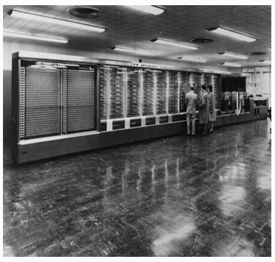
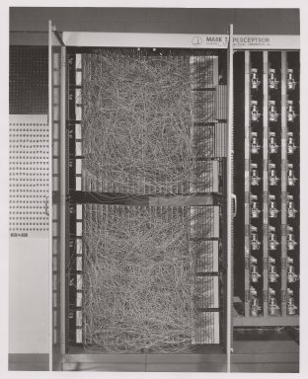
Mark I: The first perceptron
Notes:
Not trained by backprop
Adjusted by hands
Large hardwired connections

Slide 19
1959 – Discovery of simple cells and complex cells
David H. Hubel and Torsten Wiesel
Notes:
Cat experiment
Find how our brain, particularly how neurons activate on giving different inputs

Slide 20
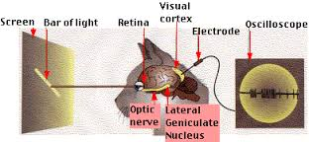
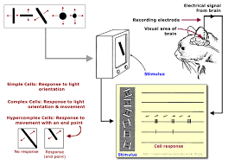
The Cat Experiment
Experiment’s video
Notes:
Cat experiment
Find how our brain, particularly how neurons activate on giving different inputs
Revealed that particular sets of neuron are fired on a particular alignment of line and that various neurons are completely inactive during certain input(sparsity)
This shows how a biological experiments are a big influence on deep learning technique but are not directly associated. In sense it’s is not directly proportional how cats and a neural network learn but the perceptron or any deep learning algorithm can be thought of as a good intuition as to what happens inside the brain.

Slide 21
1960, 1986 – Backpropogation
David Rumelhart, Geoffrey Hinton, and Ronald Williams.
Notes:
Cat experiment
Find how our brain, particularly how neurons activate on giving different inputs

Slide 22
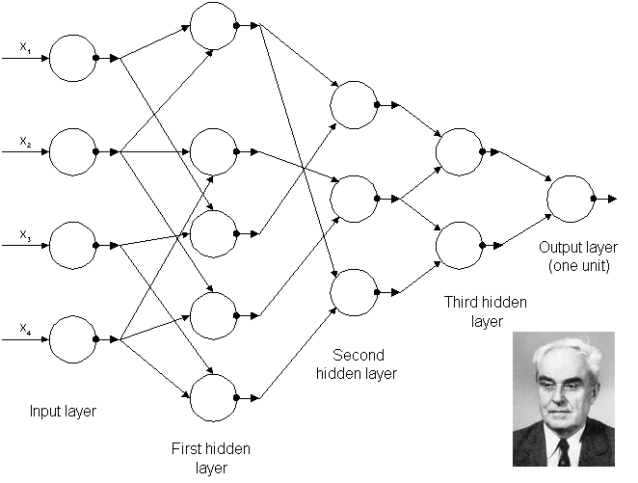
1965 - First working deep Learning network
Notes:
The first neural network trained by Alexey
He is dubbed as father of deep learning.
Ivakhnenko developed the Group Method of Data Handling (GMDH) – defined as a “family of inductive algorithms for computer-based mathematical modeling of multi-parametric datasets that features fully automatic structural and parametric optimization of models” – and applied it to neural networks.
For that reason alone, many consider Ivakhnenko the father of modern deep learning.
His learning algorithms used deep feedforward multilayer perceptrons using statistical methods at each layer to find the best features and forward them through the system.
Using GMDH, Ivakhnenko was able to create an 8-layer deep network in 1971, and he successfully demonstrated the learning process in a computer identification system called Alpha.

Slide 23
1979-80 – An ANN learns how to recognize visual patterns
Kunihiko Fukushima
Link to paper
Notes:
A recognized innovator in neural networks, Fukushima is perhaps best known for the creation of Neocognitron, an artificial neural network that learned how to recognize visual patterns. It has been used for handwritten character and other pattern recognition tasks, recommender systems, and even natural language processing.
His work – which was heavily influenced by Hubel and Wiesel – led to the development of the first convolutional neural networks, which are based on the visual cortex organization found in animals. They are variations of multilayer perceptrons designed to use minimal amounts of preprocessing.

Slide 24
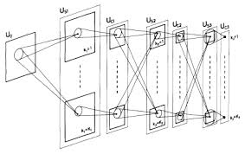
First Convolutional Neural Network
Notes:
A recognized innovator in neural networks, Fukushima is perhaps best known for the creation of Neocognitron, an artificial neural network that learned how to recognize visual patterns. It has been used for handwritten character and other pattern recognition tasks, recommender systems, and even natural language processing.
His work – which was heavily influenced by Hubel and Wiesel – led to the development of the first convolutional neural networks, which are based on the visual cortex organization found in animals. They are variations of multilayer perceptrons designed to use minimal amounts of preprocessing.

Slide 25
1982 – The creation of the Hopfield Networks
John Hopfield

Slide 26
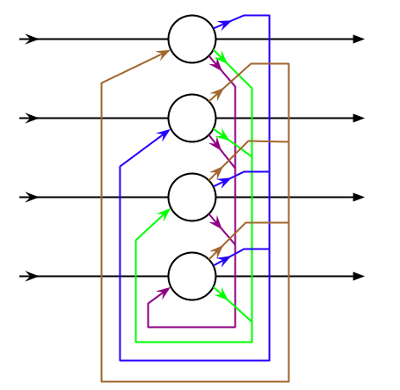
The Hopfield Networks
Beginning of RNNS
Notes:
Hopfield Networks are a recurrent neural network that serve as a content-addressable memory system, and they remain a popular implementation tool for deep learning in the 21st century.

Slide 27
1989 – Machines read handwritten digits
Yann LeCun

Slide 28

Machines read handwritten digits (LeNet)
A fundamental Convolution architecture
Notes:
LeCun – another rock star in the AI and DL universe – combined convolutional neural networks (which he was instrumental in developing) with recent backpropagation theories to read handwritten digits in 1989.
His system was eventually used to read handwritten checks and zip codes by NCR and other companies, processing anywhere from 10-20% of cashed checks in the United States in the late 90s and early 2000s.

Slide 29
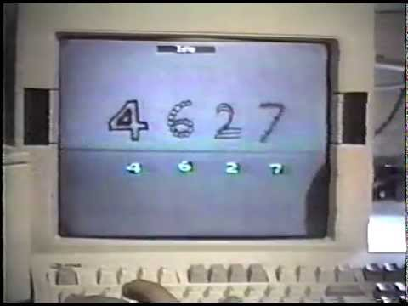
Machines read handwritten digits (LeNet)
Notes:
LeCun – another rock star in the AI and DL universe – combined convolutional neural networks (which he was instrumental in developing) with recent backpropagation theories to read handwritten digits in 1989.
His system was eventually used to read handwritten checks and zip codes by NCR and other companies, processing anywhere from 10-20% of cashed checks in the United States in the late 90s and early 2000s.

Slide 30
BUT THIS ADVANCEMENT CEASED
1998-2005
AI WINTER

Slide 31
Major reasons were hardware bottleneck and advancement in statistical machine learning methods
Also, high expectation and less deliverance

Slide 32
A statistical champion!
SUPPORT VECTOR MACHINES
Notes:
Support vector machines, or SVMs for short, are a class of machine learning algorithms that have become incredibly popular in the past few years. They are based on a very intuitive idea. Here, we’ll introduce SVMs and go through the key ideas in the algorithm.

Slide 33
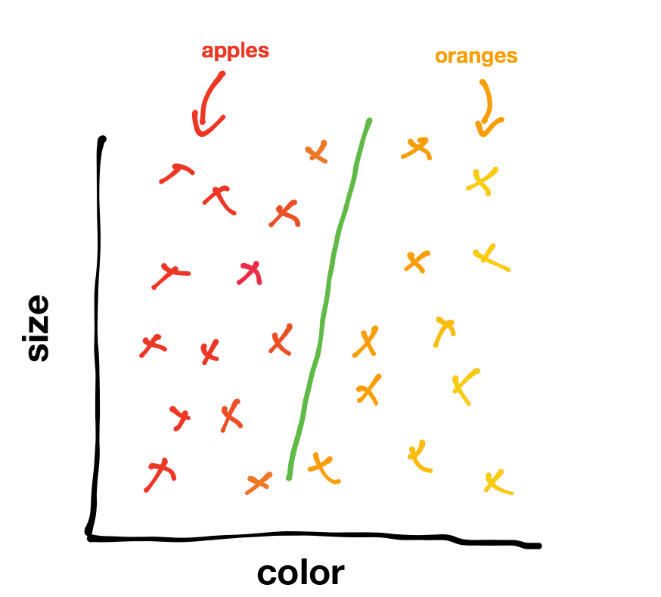
Largest Margin Classifier
Notes:
Support vector machines, or SVMs for short, are a class of machine learning algorithms that have become incredibly popular in the past few years. They are based on a very intuitive idea. Here, we’ll introduce SVMs and go through the key ideas in the algorithm.

Slide 34
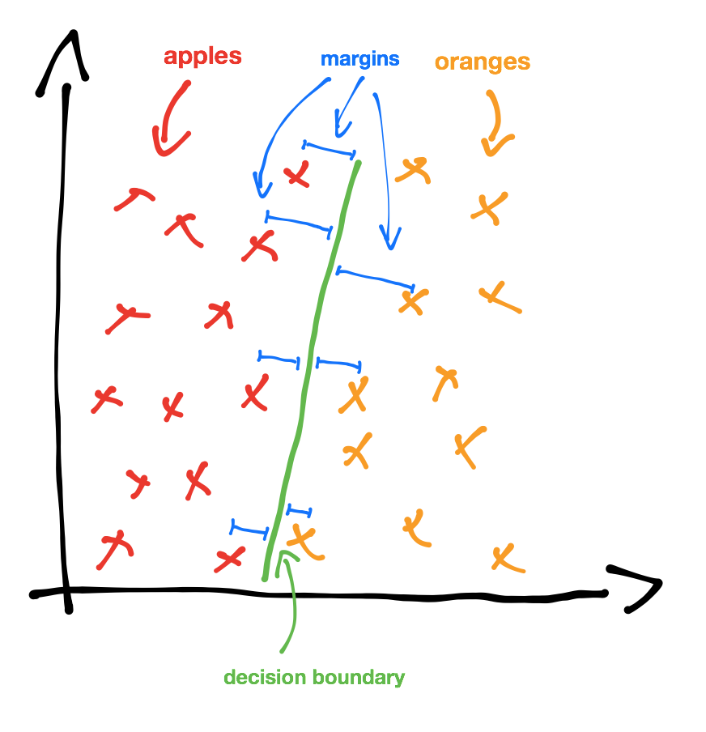
Largest Margin Classifier
Notes:
In a way, a margin is a way to determine how confident we are in our classification. If a data point has a large margin, and hence is very far away from the decision boundary we can be pretty confident about our prediction. However, if a data point has a very small margin, and is hence very close to the decision boundary then we probably aren’t as sure of our classification.

Slide 35
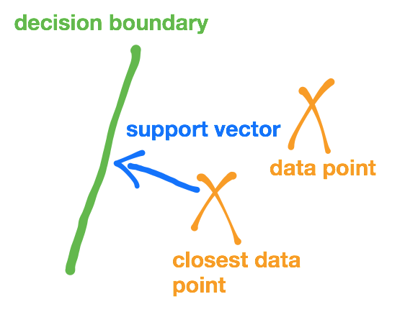
Largest Margin Classifier
Notes:
Now that we’ve defined margins, we can talk about support vectors. A support vector is a vector from the data point with the smallest margin to the decision boundary. In other words, it’s a vector between that data point that is closest to the decision boundary and the boundary itself. This vector, in fact, any margin, will be perpendicular to the decision boundary because the smallest distance between a point and a line is a perpendicular line.
The idea behind a support vector machine is to classify data by drawing a decision boundary such that it maximizes the support vectors. By maximizing the support vectors, we’re also maximizing the margins in a data set, and thus the decision boundary is as far away as possible from the data points.

Slide 36
But to defeat Neural nets you must have non-linearity
Notes:
Neural nets are famous for they can deal easily with non-linearity and hence shine when data is high dimentional

Slide 37
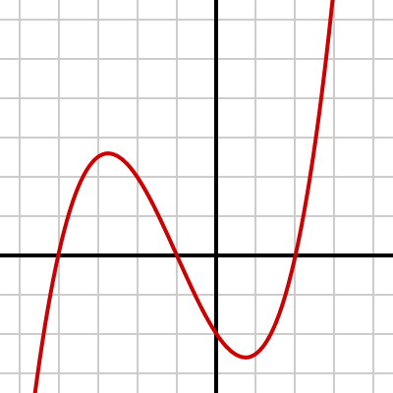
What is non-linearity ?
Notes:
Neural nets are famous for they can deal easily with non-linearity and hence shine when data is high dimentional

Slide 38
think not,
Support Vector Machines with Kernel Trick

Slide 39
What is a kernel?
Kernel Functions can be thought of as similarity functions which can map inner products of very high dimensional points without actually calculating their coordinate.
For example:
K(x, x′)=(x^{T}x′ + c)^{d}
This is polynomial kernel.
*this topic is math heavy, i’ll skip the maths but you can read it here.
Notes:
It turns out that for certain representations of data (or certain coordinate systems), it’s actually much easier to calculate the kernel than it is to calculate the actual data point. For example, we can use data points in an infinite dimensional space. As long as we have a way of computing the inner product, or the kernel, quickly. And luckily, there are ways to do this! One example of this is the Radial Basis Function kernel, which calculates the inner product for a certain infinite dimensional space.

Slide 40
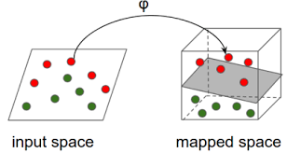
What is a kernel?
Kernel is used to map low dimensional data to high dimension such that it becomes sparse and a decision boundary can be formed.

Slide 41
Live Demo of SVM
-click here

Slide 42
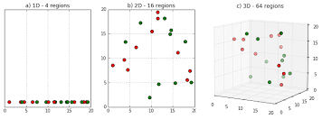
Why is high dimensional data sparse?
Curse of Dimensionality
Notes:
Explain curse of dimensionality
Good if you have a lot of data or if data is non separable in lower dimension but can be separated in higher dimension

Slide 43
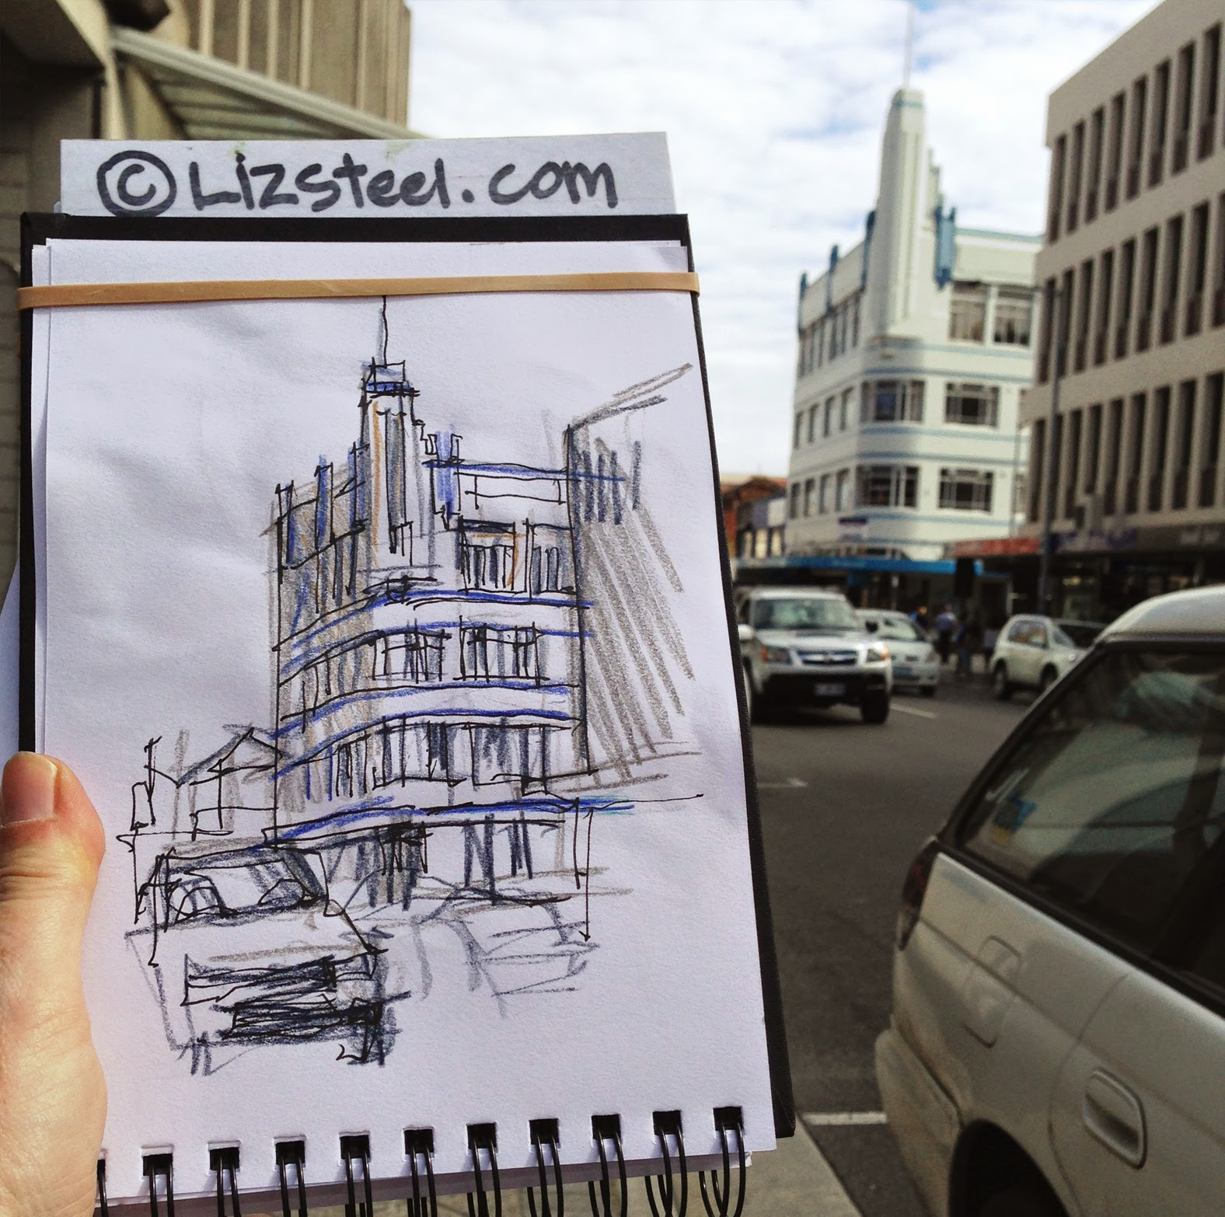
Curse of Dimensionality
If we have data which is inseparable in lower dimension, we can map it to a higher dimension thus increasing sparsity and making them separable
Notes:
Explain curse of dimensionality
Good if you have a lot of data or if data is non separable in lower dimension but can be separated in higher dimension

Slide 44
Curse of Dimensionality
But very high dimensional data such as images are very dramatically affected by this as only a small image of pixel size 28x28 has feature size,
28*28*3 - total dimension/ parameters
Each can take a value between 0-255
Hence total number of images:
256^{28*28*3} ; these are a lot of images!
Full HD images have size of - 1920x 1080
Notes:
Explain curse of dimensionality
Good if you have a lot of data or if data is non separable in lower dimension but can be separated in higher dimension

Slide 45
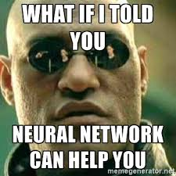
Failure of SVM and resurgence of Neural Nets
Key points to failure of SVMs
Perhaps the biggest limitation of the support vector approach lies in choice of the kernel.
Since SVM is non-parametric model it is difficult to train it online (stochastically)
Involve a complicated mathematical structure than neural networks
Cannot be modularized
Notes:
Judging from the examples you provide, I'm assuming that by ANNs, you mean multilayer feed-forward networks (FF nets for short), such as multilayer perceptrons, because those are in direct competition with SVMs.
One specific benefit that these models have over SVMs is that their size is fixed: they are parametric models, while SVMs are non-parametric. That is, in an ANN you have a bunch of hidden layers with sizes h₁ through h_{n} depending on the number of features, plus bias parameters, and those make up your model. By contrast, an SVM (at least a kernelized one) consists of a set of support vectors, selected from the training set, with a weight for each. In the worst case, the number of support vectors is exactly the number of training samples (though that mainly occurs with small training sets or in degenerate cases) and in general its model size scales linearly. In natural language processing, SVM classifiers with tens of thousands of support vectors, each having hundreds of thousands of features, is not unheard of.
Also, online training of FF nets is very simple compared to online SVM fitting, and predicting can be quite a bit faster.

Slide 46
Resurgence of Neural Nets
In 2005, Geoffrey Hington, Father of modern deep learning, came out with a strategy to piecewise train layers of a deep learning system. This method is called
DEEP BELIEF NETWORKS.
After that, many records and state of the arts were shattered by deep network systems

Slide 47
Resurgence of Neural Nets
Some of the amazing use cases and milestone of deep learning systems are:
Object classification ( human error- ~5%; deep nets: 2.27%)
Self driving cars
Snapchat filters
Machine Translation of 80 odd languages
Recreating blurry images
Writing new chapter of harry potter series
And list goes on..

Slide 48
But to understand resurgence we need to know,
What is a Neural network, exactly?

Slide 49
What is a Neural network exactly?
Neural network are basically a NET of functions(nodes) stacked horizontally and vertically. Likewise in human brain.
Each node twisting and turning the plane in a specific direction to make the data linearly separable.

Slide 50
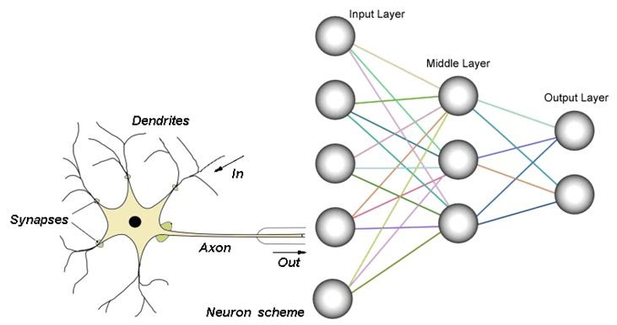
What is a Neural network exactly?
Neural network are basically a NET of functions(nodes) stacked horizontally and vertically. Likewise in human brain. Layers of neural nets stacked together is called a DEEP LEARNING SYSTEM

Slide 51
What is a Neural network exactly?
Each function(nodes) turns the data plane in such way that a line can be drawn through it.
But Turn, how?
Demo 1 Demo 2

Slide 52

So do we hard code each node involved in it?
No, we feed in the data and let computer LEARN from the data itself.

Slide 53
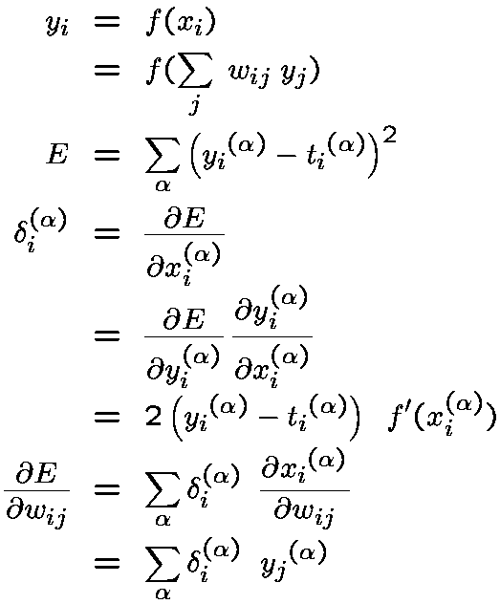
So do we hard code each node involved in it?
At the heart of deep learning or neural network there is differentiation and matrix multiplication, disguised in the name of
BACKPROPOGATION.
A topic for standalone talk itself.

Slide 54
Parallel computing, a lot of matrix multiplication, that is similar needs of a modern computer games!

Slide 55
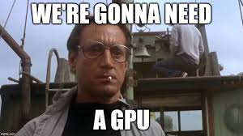
And like computer gaming we require GPU to run big and bulky networks

Slide 56
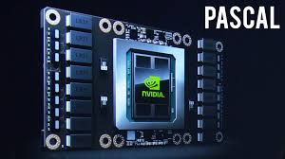
Comes in nvidia

Slide 57
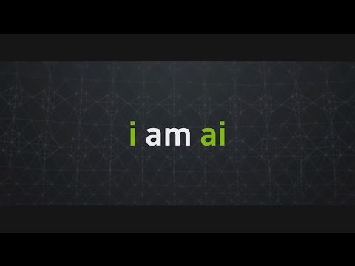
So let’s start with some of the coolest application of deep learning

Slide 58
Let’s hit up live demos!
RNN based handwriting generation
Neural caption generation
Reconstructing Human written digits
Computer playing a duet with you
And many more!

Slide 59
Now comes the learning part!
It’s your turn to ask the following questions:
Where should I start?
What are the prerequisites?
- and any questions!
Go shoot!

Slide 60
THANK YOU!

